Slide 1
Air Quality Monitoring System
Sai Praveen Reddy Allam (2043208)

Slide 2
Problem Statement
To make work from office safe and secure for employees during the pandemic, a continuous air quality monitoring system needs to be implemented across three floors of the building. The system will provide an air quality index to each individual's desktop with alerts and preventive actions communicated when air quality exceeds threshold values.

Slide 3
Proposed Solution
To monitor air quality in an office building, air quality sensors will be installed on each floor adjacent to smoke detecting sensors and in smoking zones. The sensors will be connected to a microcontroller which collects and transmits data to a cloud-based web server for storage. An application on the web server will analyze the data and provide an air quality index, with alerts and preventive actions sent to employees' smartphones when the air quality level exceeds threshold values. The system will be fully automated and integrated, with a feature for users to access the application to view the air quality status anytime.

Slide 4
Strategy Implemented
A Spring Boot application was developed to generate random data for the gases present on each floor of an office building.
The air quality data was transmitted to AWS IoT Core, where it was processed by IoT rules and sent to specific Lambda functions for further processing. The Lambda functions then stores the real-time data in DynamoDB and processes the historical data for storage in S3.
The Lambda function is used to calculate the air quality index of each floor and verify the generated data for any errors. If any error is detected, the isError flag is set to True for further handling.
A new Spring Boot application was created to fetch data from DynamoDB. This app provides the current air quality data as well as the most recent air quality data recorded on the respective floor in JSON format.
A React-based frontend application was developed, which takes the endpoints of a REST API to display air quality data to users. The application showcases the air quality data with respect to the floor and provides alerts based on the air quality value.

Slide 5
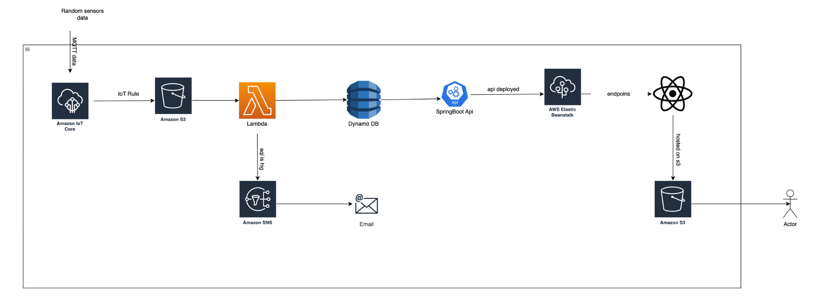
System Design

Slide 6
Technologies Used
Development Tools : Visual Studio, Amazon Web Services
Database: AWS Dynamo, AWS S3
Programming Languages : Java (SpringBoot Framework), Python, React (JavaScript library)

Slide 7
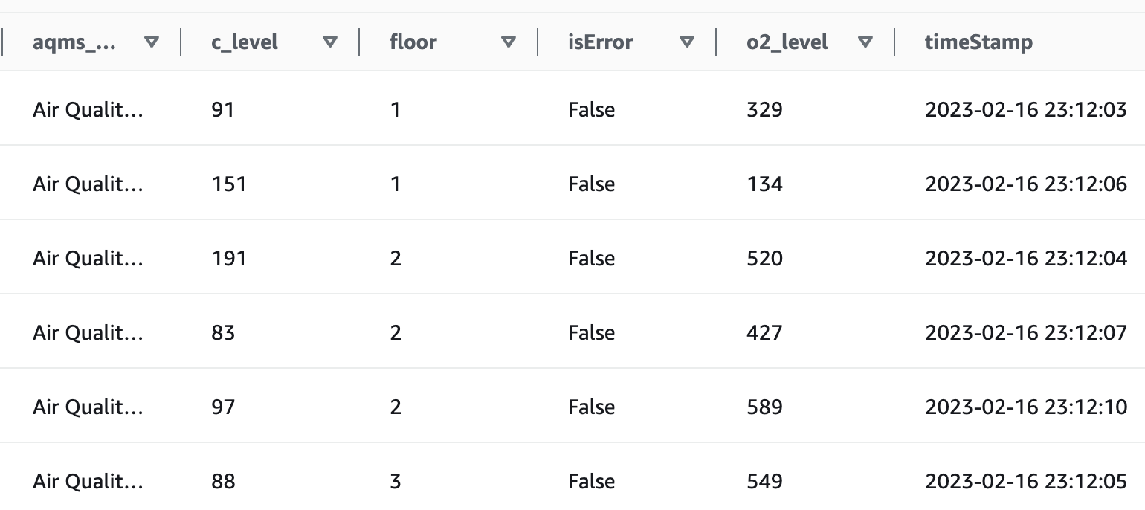
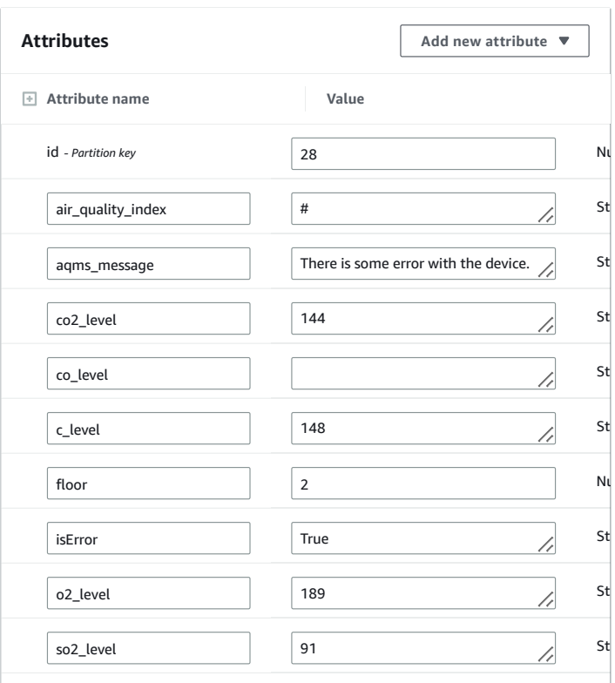
Database (DynamoDB)

Slide 8
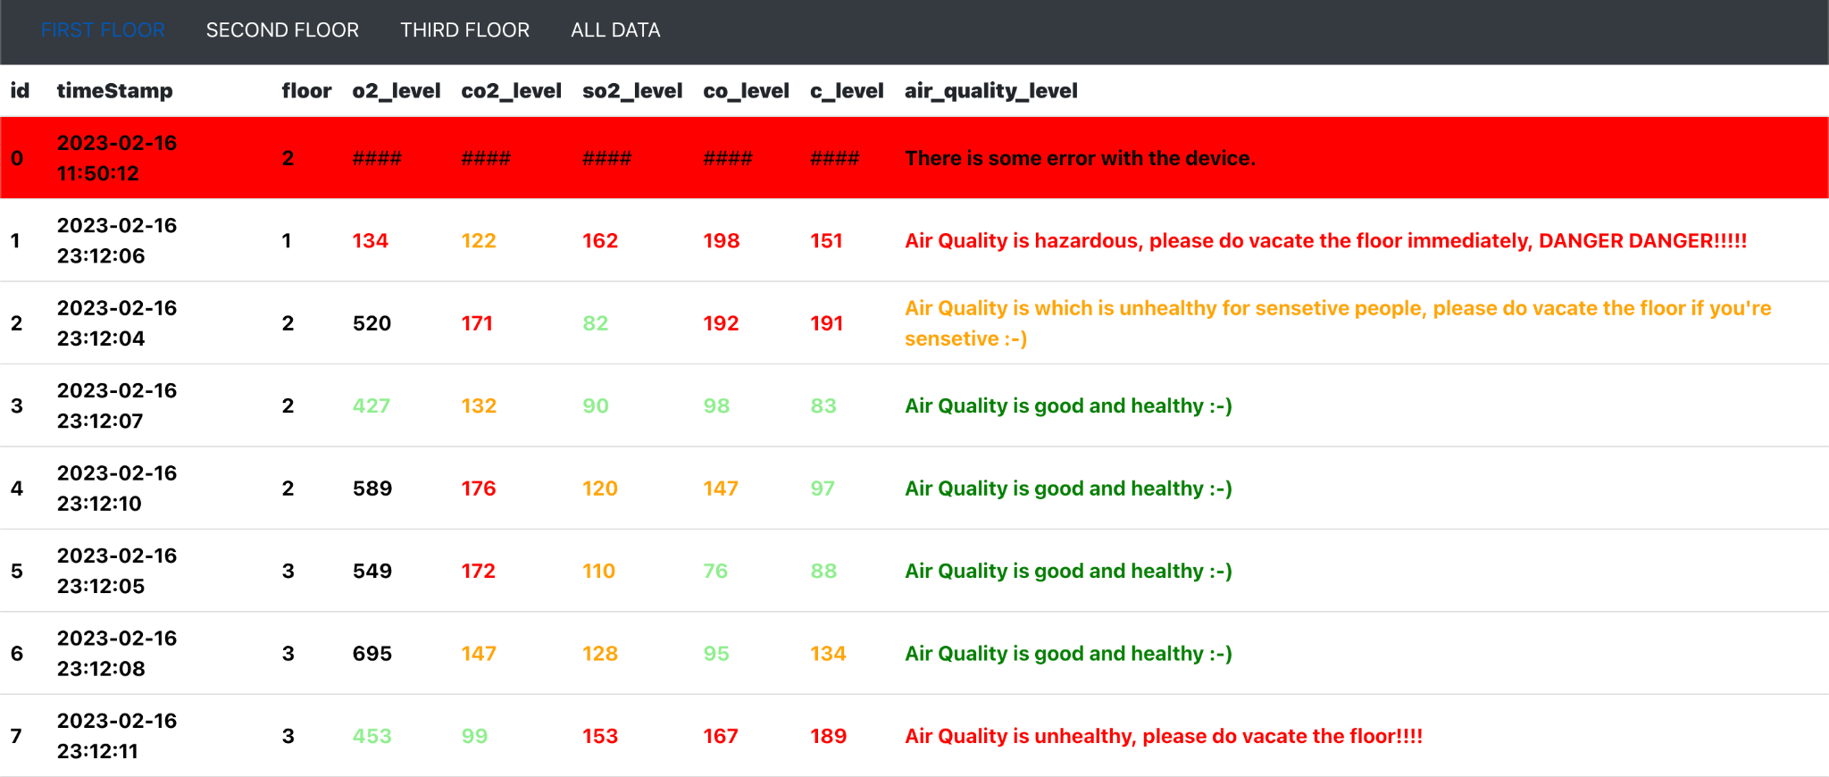
Live Data info

Slide 9
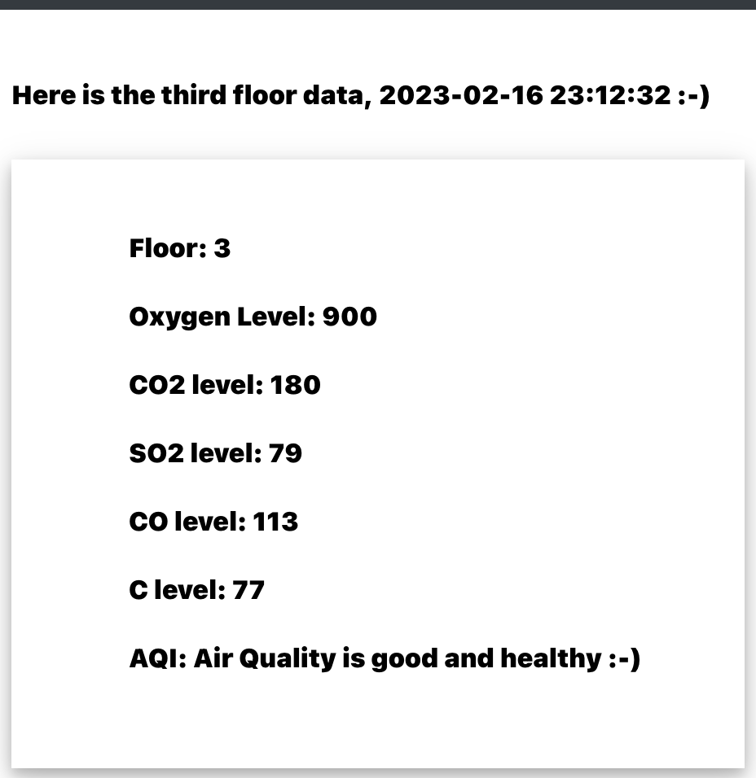
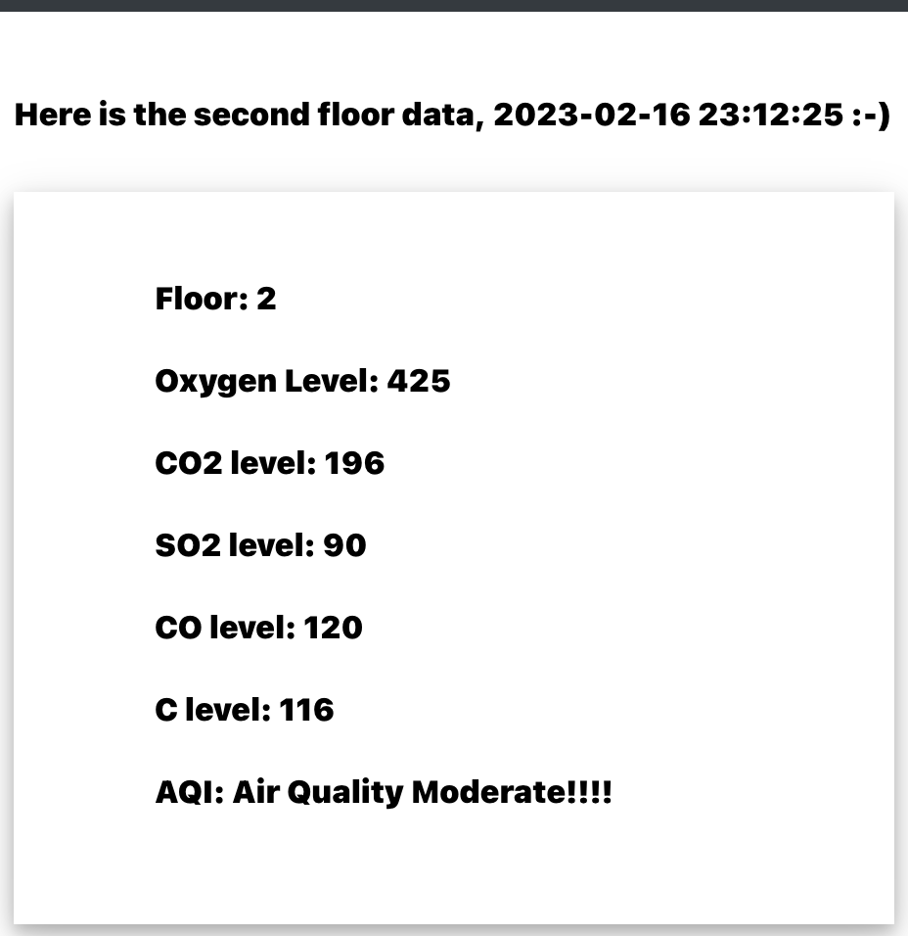
Floor wise latest recorded data from Air Quality Device

Slide 10
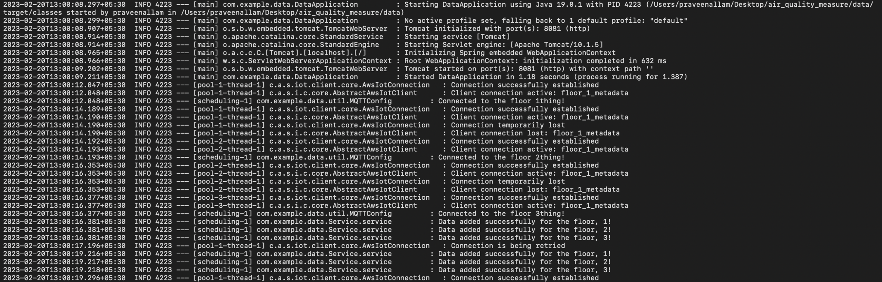
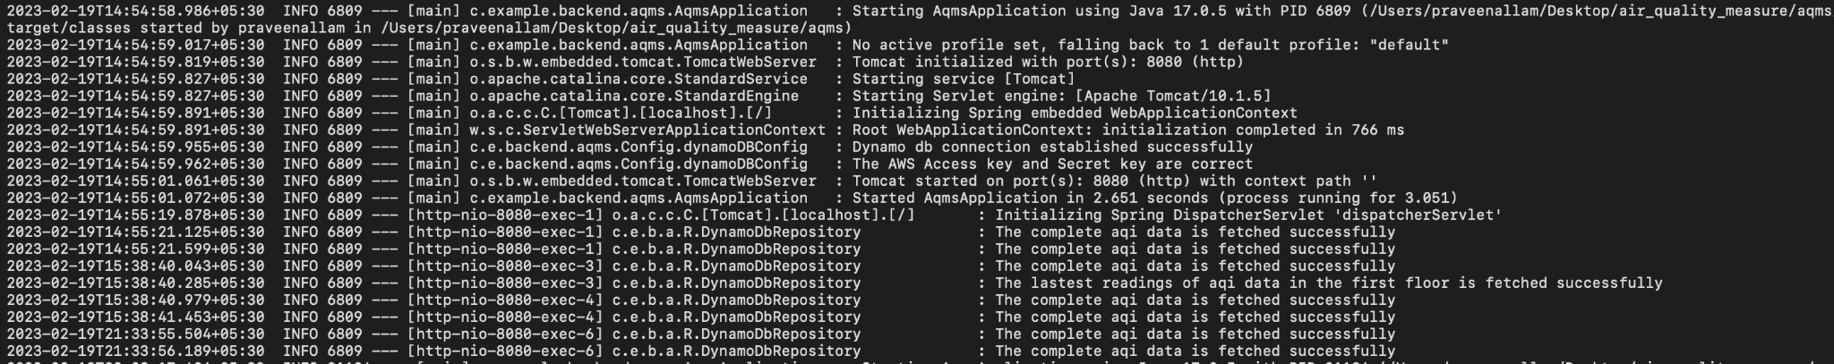
Log Files

Slide 11
Conclusion
It is important to ensure good air quality in indoor spaces, and an air quality monitoring system can help in achieving this. In this project, I have designed and implemented an air quality monitoring system using various technologies and tools. The system is built using a combination of Java (SpringBoot Framework), Python, and JavaScript (React library) programming languages, and is deployed on the Amazon Web Services (AWS) cloud platform.
Overall, this air quality monitoring system provides real-time data on the air quality of each floor in the building, helping employees take preventive actions to ensure a healthy and safe indoor environment.

Slide 12
Thank You!

